Slide 1
CSE6006–NoSQL Databases
J Component - Project Report
SECURED SHARING SENSITIVE DATA IN BANKING PLATFORM
By
20MCS1006 A.JAFFLET TRINISHIA

Slide 2
Introduction
Secure Sensitive Data is more important in Banking Platform
Here in our project we going to secure the data with different modules of personal loan section.
we are using Proxy Re-Encryption algorithm In addition to that all the data are in Graphical view.

Slide 3
Objective
we introduce new method to secure the data with Proxy Re-Encryption (PRE)
It will work internally which secure the data in the transmission and stores the required data with more secure

Slide 4
Challenges
So now a day’s transferring the data is done using electronic data with a hypertext or public key or using the private key
The key generation is taken time and also it is not flexible as normal
Another method used is encryption and decryption and it requires external software to work on it and also takes time

Slide 5
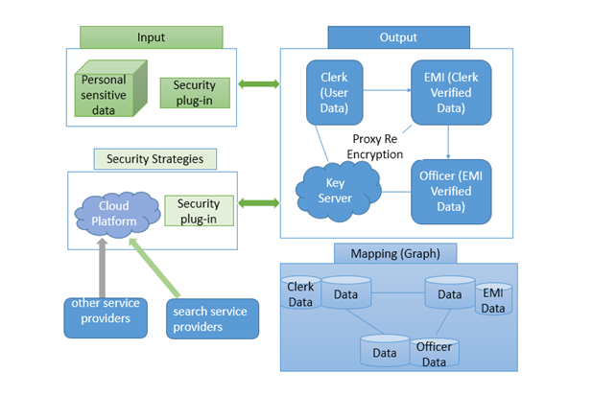
System architecture

Slide 6
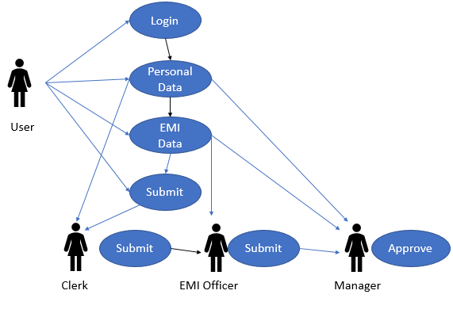
Flow chart

Slide 7
Data Set Description
Data set consist of four parts namely
1. General information :
Name
DOB
Gender
mail id
phone numer
address
2. Previous loan details :
emi and other information of the user
3. other Information :
Information about the property
vehicle of the customer
Information about the job
4. Loan amount require
Purpose
Amount
Percentage of interest
Description of the data source

Slide 8
Proxy Re-Encryption algorithm
It is mainly used to secure the data without Decrypting through external software.
And also we use mapping system to divide the Data as per the Requirements of the officers.
Used to secure the data from storage to cloud

Slide 9
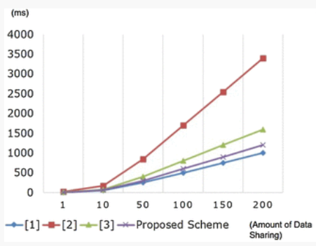
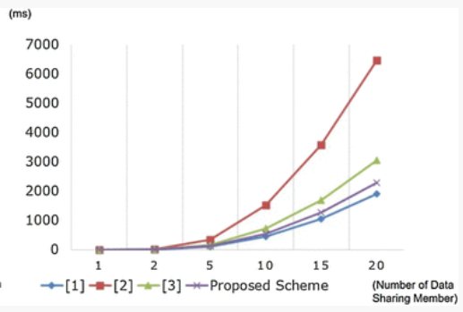
Discussion of performance metrics :

Slide 10
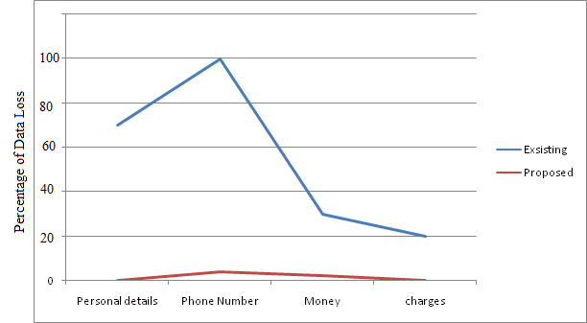
Comparison Graph

Slide 11
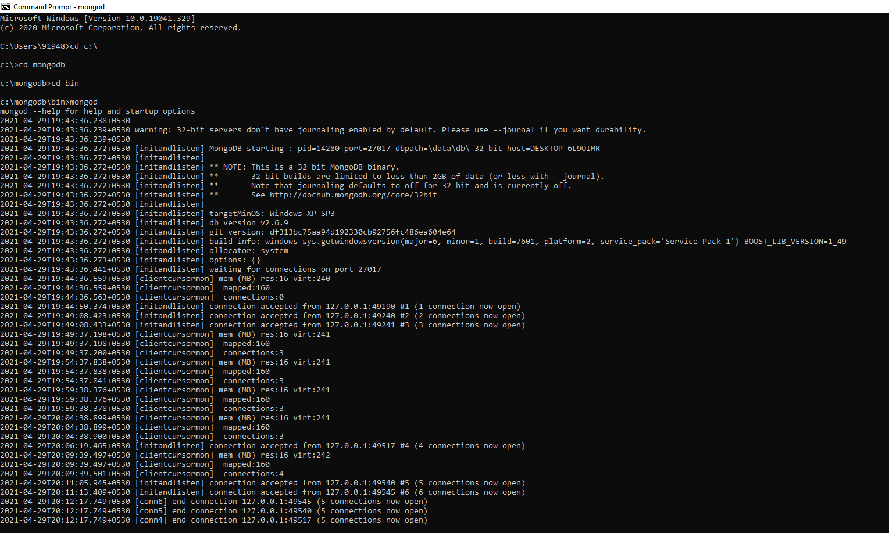
Mongodb

Slide 12
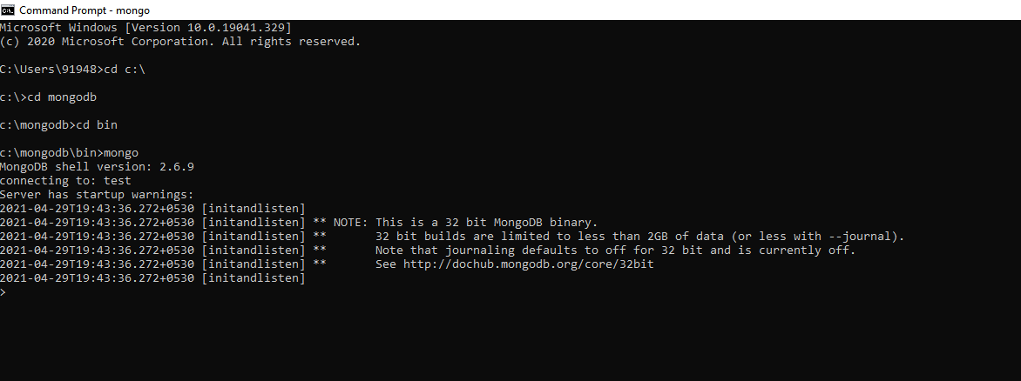

Slide 13
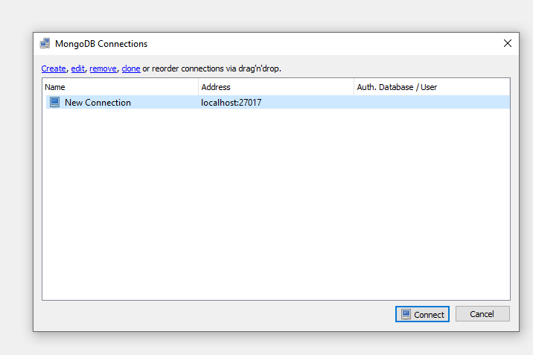
connecting Robomongo :

Slide 14
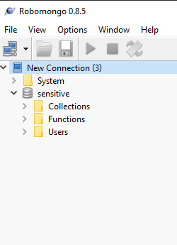
After connecting Robomongo

Slide 15
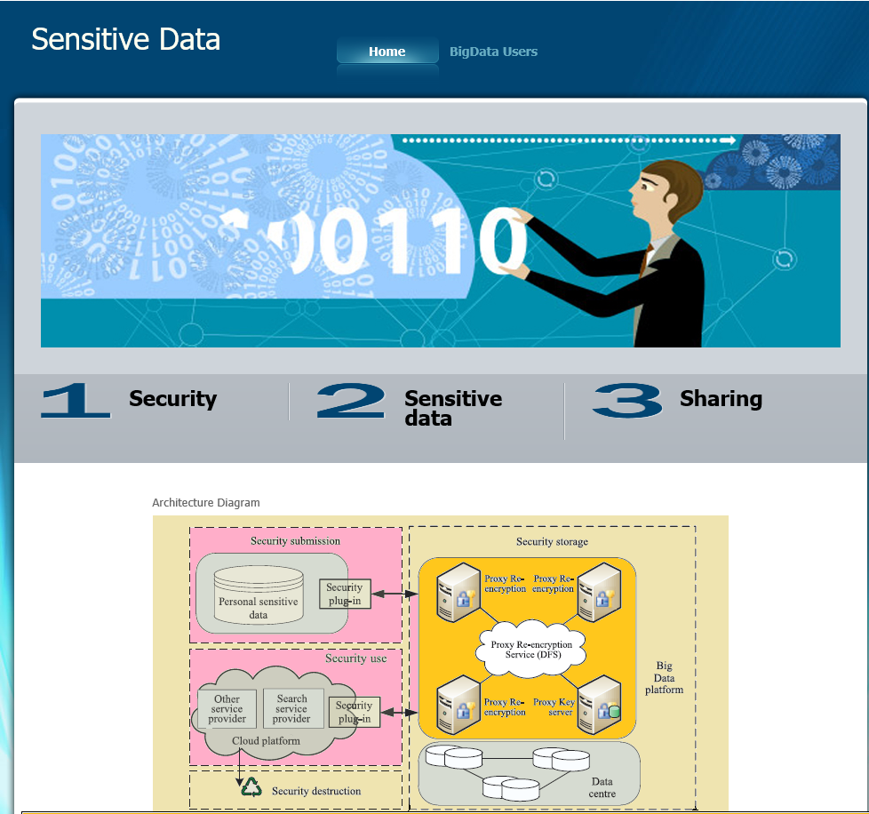
Output:

Slide 16
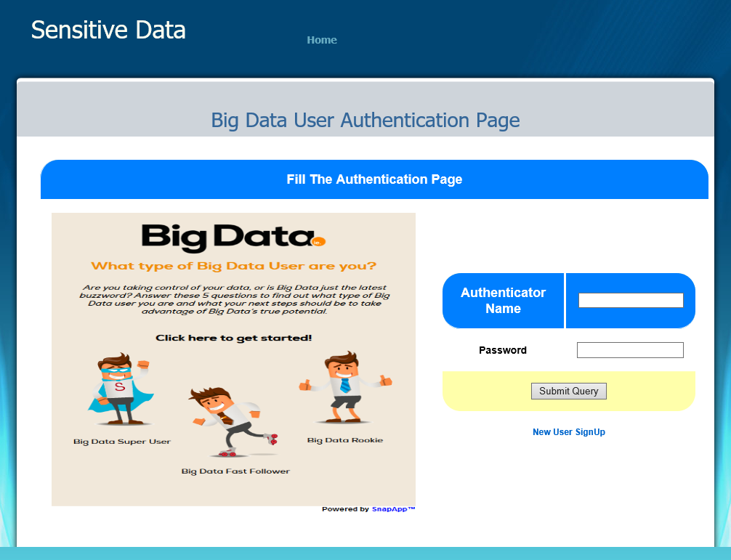
Login page :

Slide 17
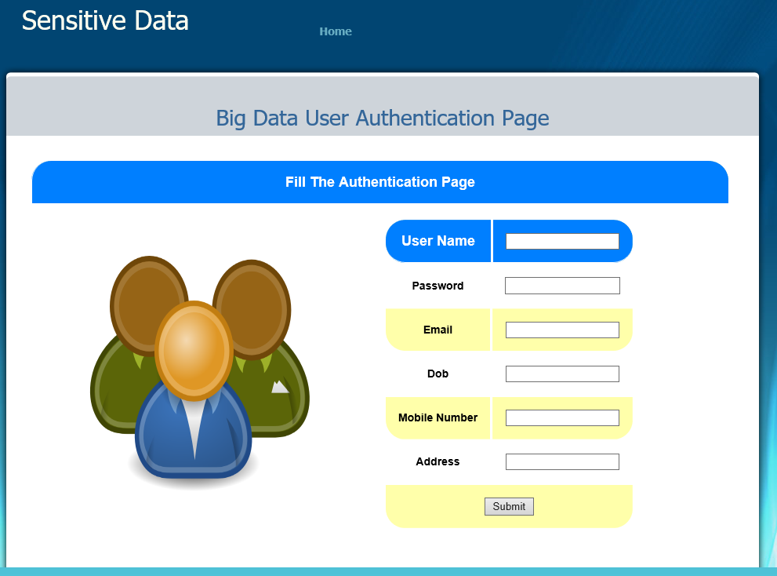
Creating account :

Slide 18
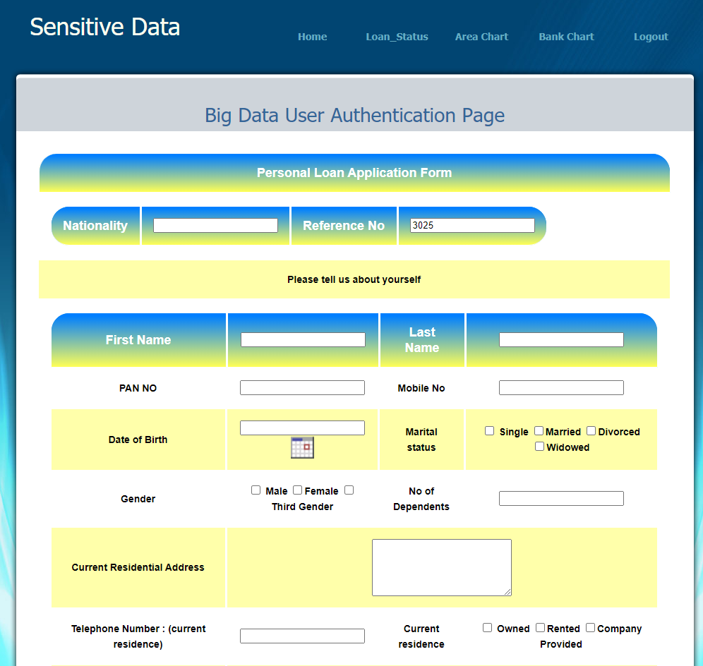
Authentication page

Slide 19
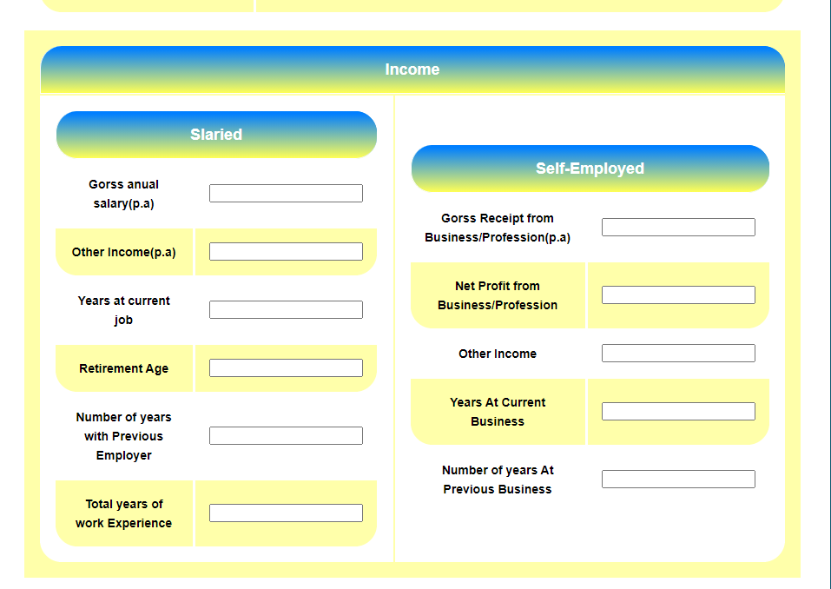
Income details

Slide 20
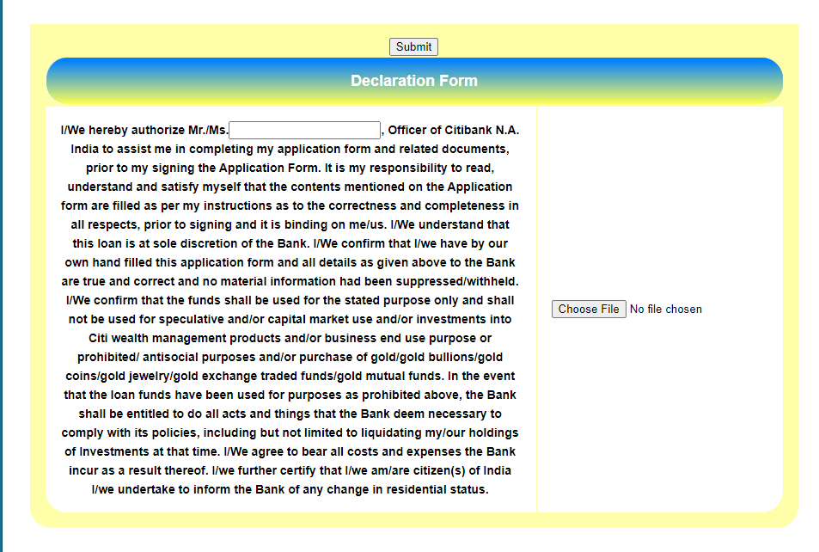
Declaration page

Slide 21
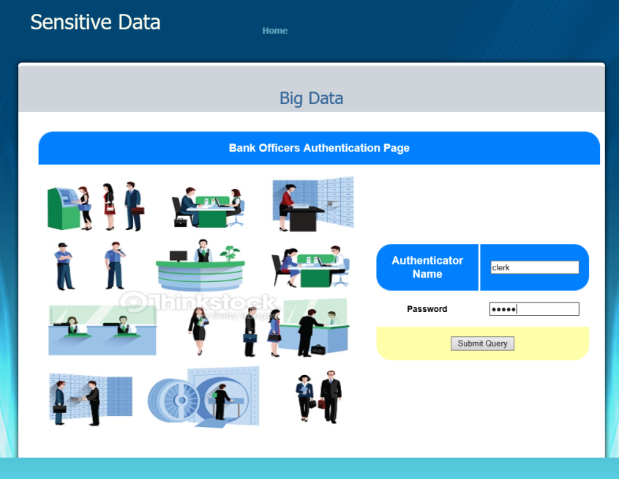
Login page for the workers :

Slide 22
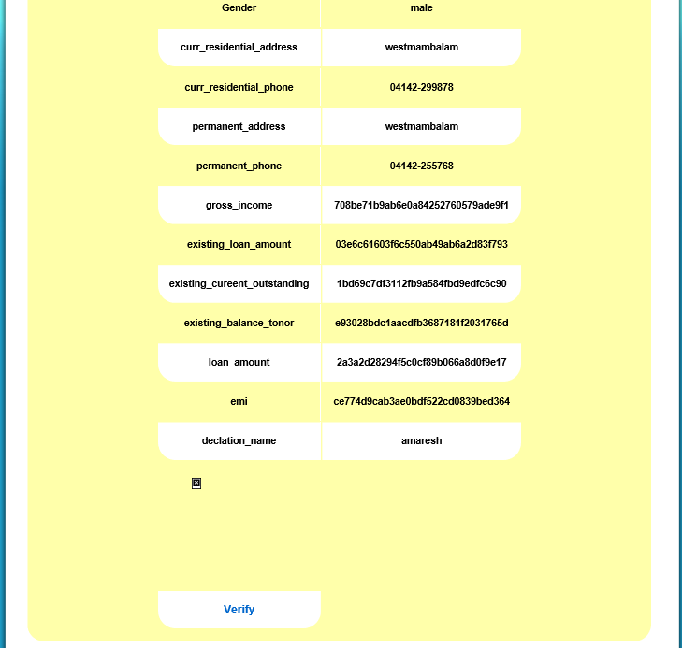
Values that are encrypted

Slide 23
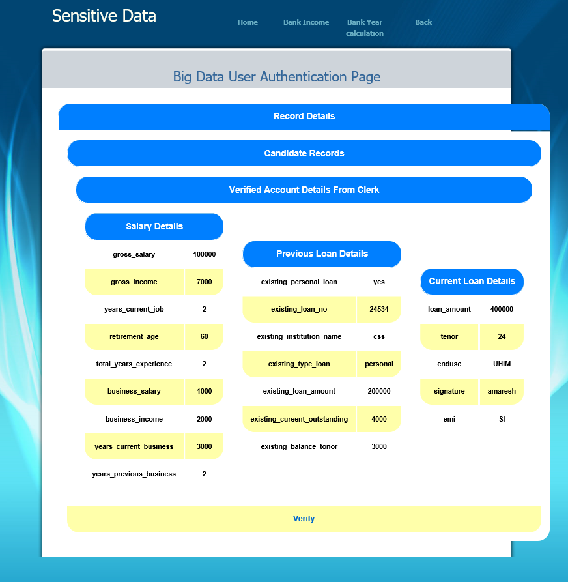
Values that are dencrypted

Slide 24
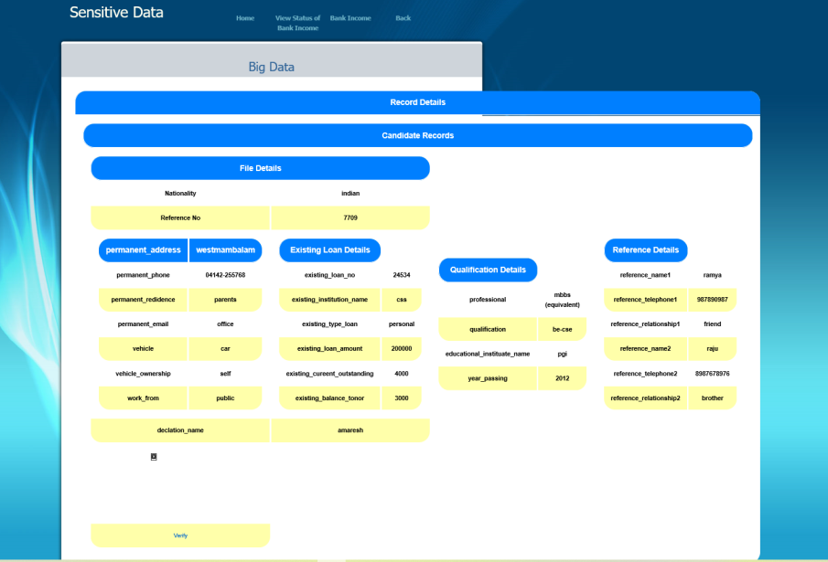
Filtered values

Slide 25
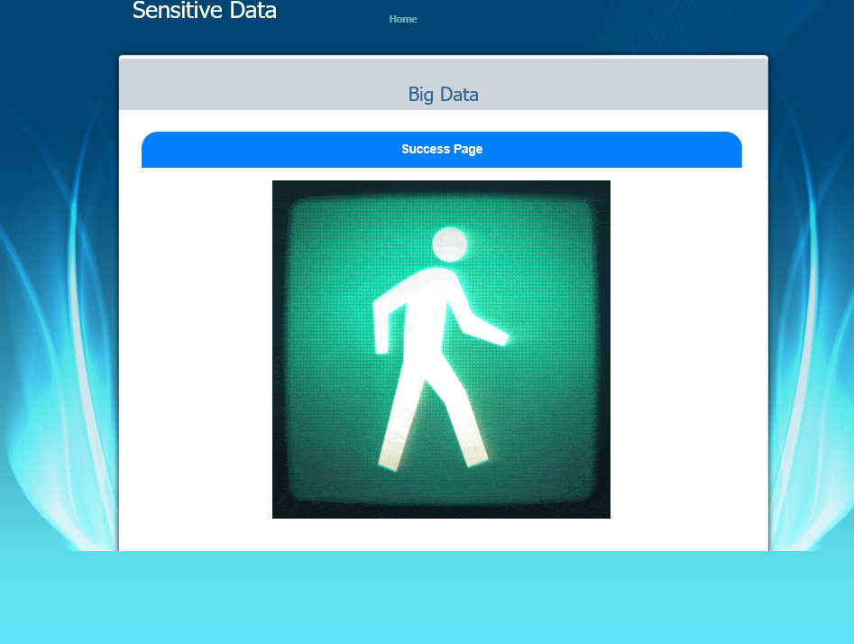
Loan approved :

Slide 26
Conclusion
The proposed framework well protects the security of users’ sensitive data.
At the same time the data owners have the complete control of their own data
As the data's are visible only to the respective authorities there will not be any lose of data and lose of information

Slide 27
Future Work
Enhancements can be affixed by changing the current modules or adding new modules for all the sector in the bank
One important development that can be added to the project in future is secure file in dividing node, which is presently done for replicated files.

Slide 28
Reference :
J. D. Preece and J. M. Easton , Towards Encrypting Industrial Data on Public Distributed Networks Date Added to IEEE Xplore: 24 January2019
Thanh Dat Dang, Doan Hoang, and Diep N. Nguyen , Trust-based Scheduling Framework for Big Data Processing with MapReduce , Added to IEEE Xplore:September
Mansukhdeep Kaur, Mohnsin Murtaza, Mostafa Habbal, Post study of Blockchain in smart health environment Networks Date Added to IEEE Xplore: March 2021
Yu Jin, Chuan Tian, Heng He1, Fan Wang, A Secure and Lightweight Data Access Control Scheme for Mobile Cloud Computing , Date Added to IEEE Xplore: October2015.

